Slide 1
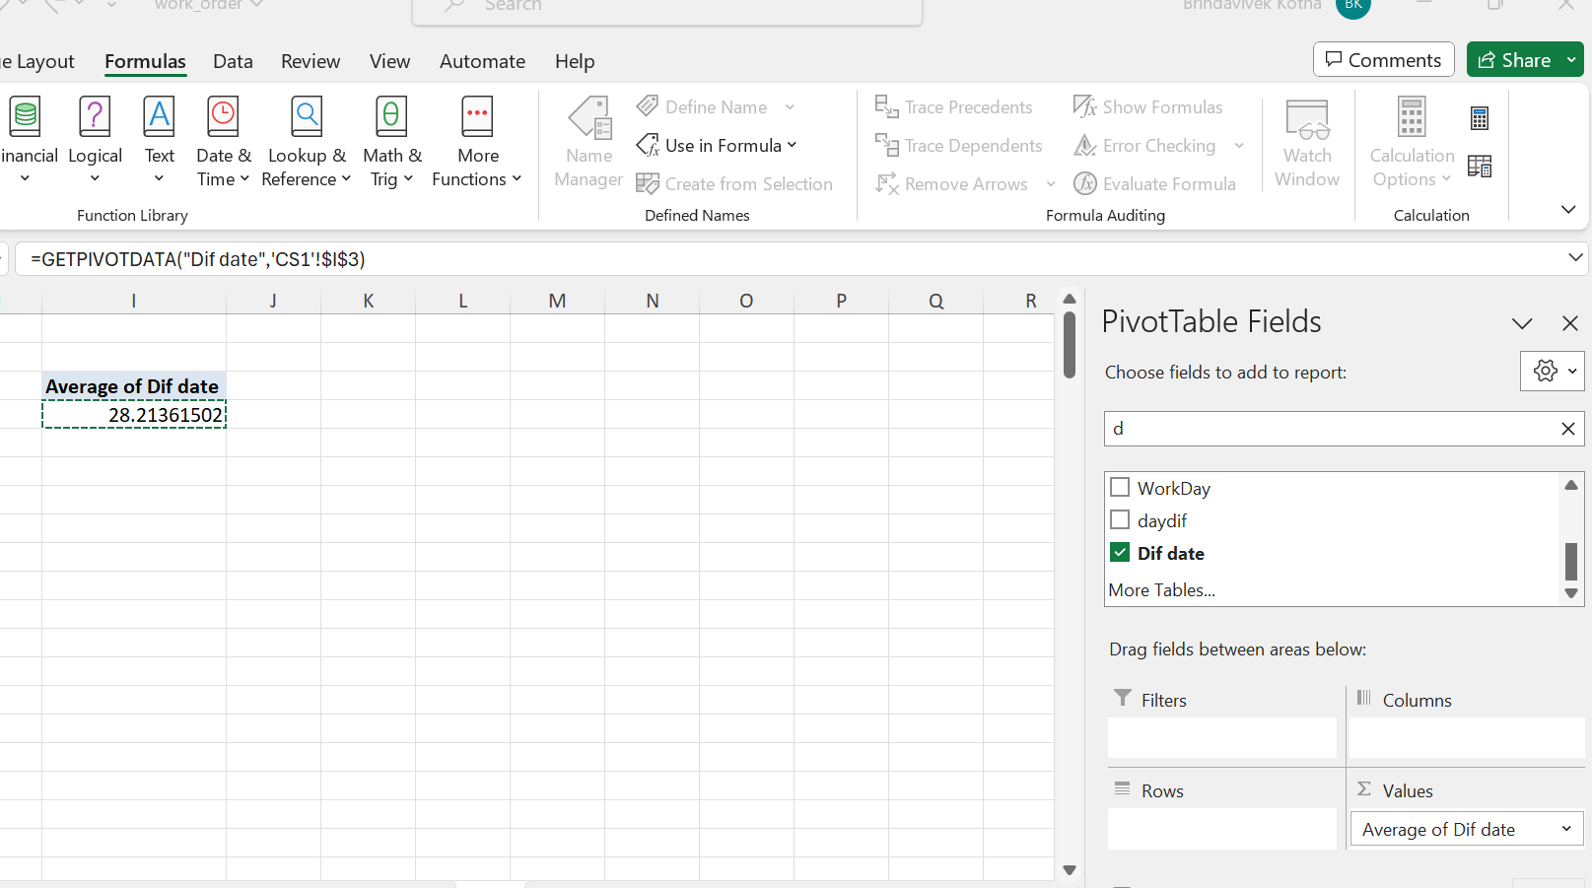
1)Average leadtime between request date and completion date
=DAYS(G2,F2) to get
date difference
Value may be negative
for blanks
And if value>0 return
same value else fill NA
=IF(W3>0,W3,"NA")
So that no null values
are considered

Slide 2
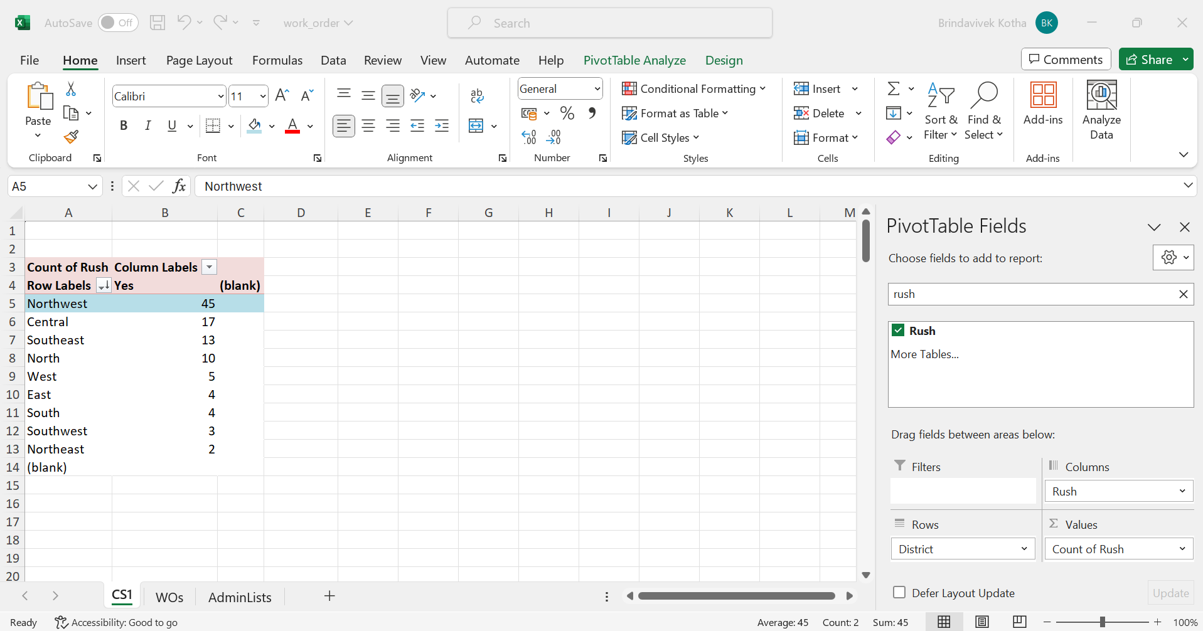
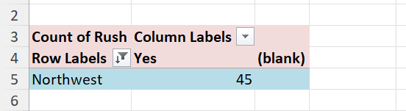
2)District that has highest no.of rush jobs
Northwest district has highest no. of rush jobs
Steps:
Pivot table, district in
rows and count of
crush jobs in values
sort according to count
of rush
Value filter then top 1

Slide 3
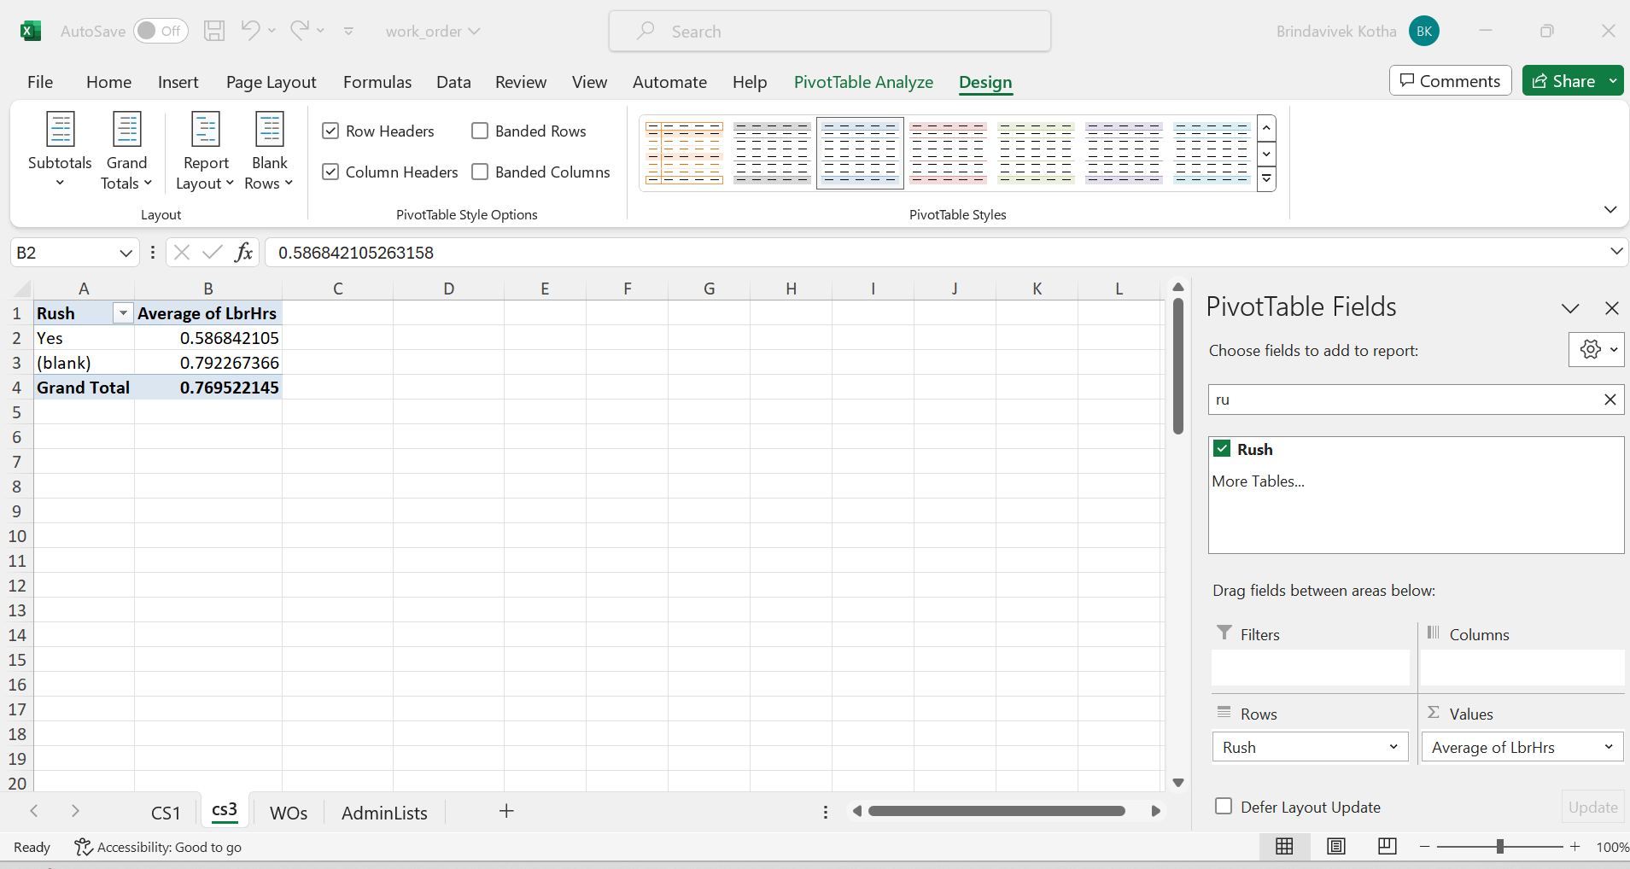
3)Difference between Average Labour hours of rush and non rush jobs
Avg labour hours of rush jobs is less than avg lbhrs of non rush jobs
This infers rush jobs have less labour hours than non rush jobs
0.57 is avg of rush lbhrs
0.79 is avg of non rush
lbhrs
0.79<0.57

Slide 4
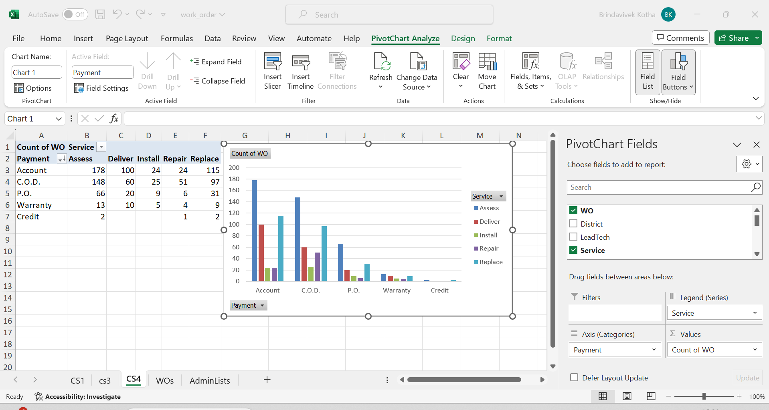
4)Distribution of payment types across services
Payment from account has highest no.of services
Payment from credit
card has least services.

Slide 5
5)Trend of payments over years
Extract year by using =TEXT(F2,"yyyy")
Then inset pivot table
Payment in rows and year in col count of wo in values
Then sort in descending of count of orders
Then insert a line chart to know the trend

Slide 6
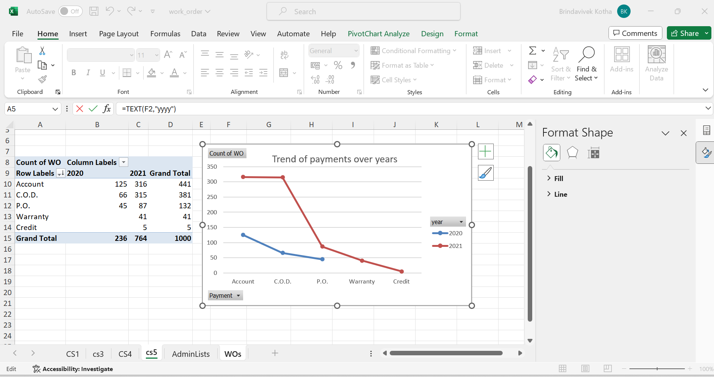
Q5)insights
2021 has more orders in each payment method

Slide 7
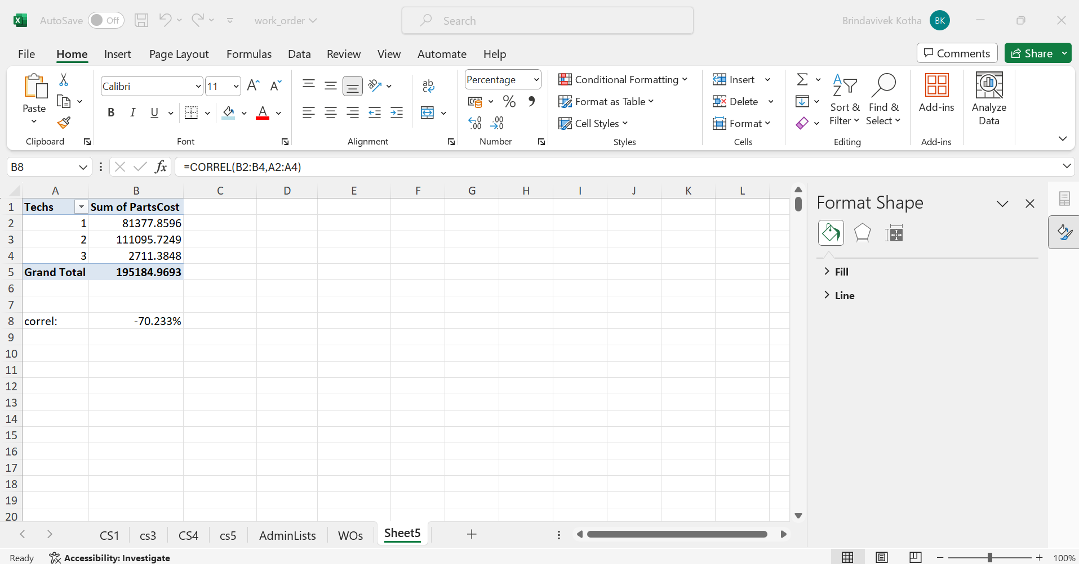
6)Relationship between no.of techs and partcost
Correl formula to know the relationship
=CORREL(B2:B4,A2:A4)
-70.23 is high correlation and
the relationship is indirect.If
no.of techs increases then sum
of parts decreases

Slide 8
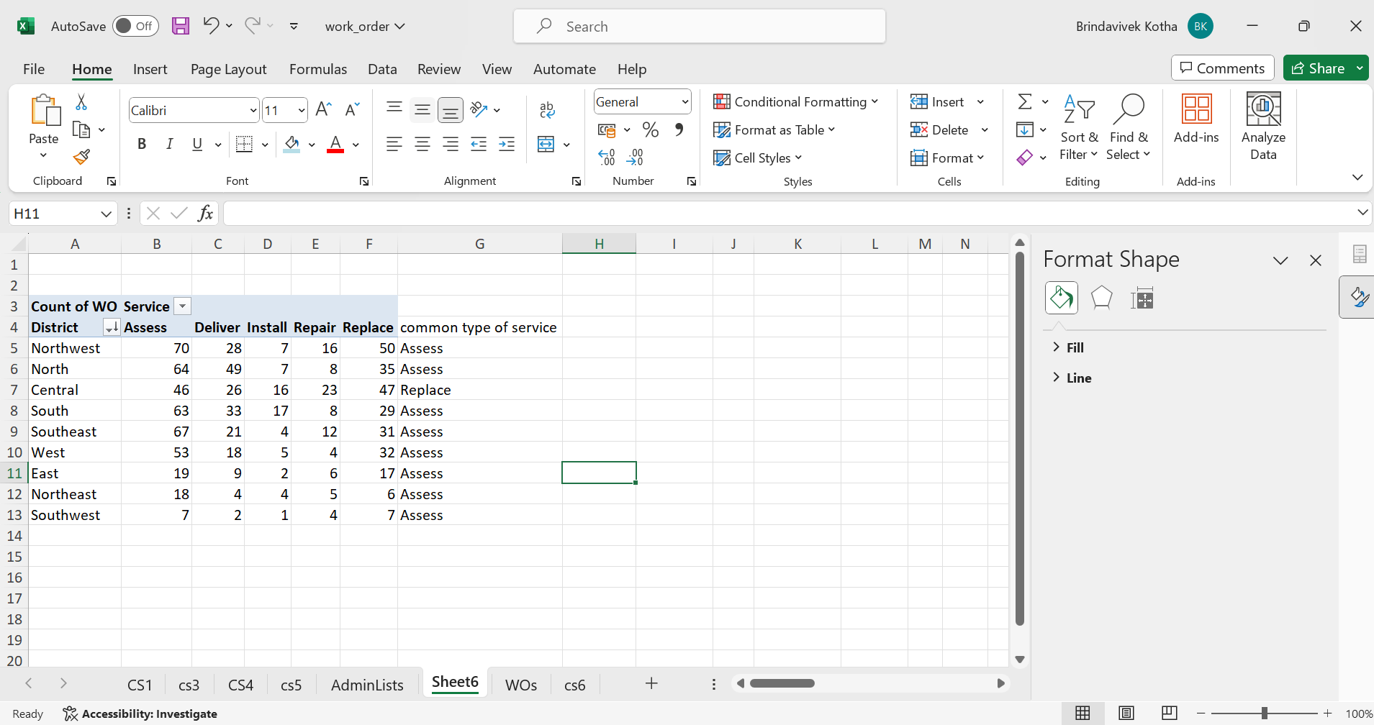
7)Most common type of service requested in each district
Index formula to know the index of max count
=INDEX($A$4:$F$13,1,MATCH(MAX($B5:$F5),$B5:$F5,0)+1)

Slide 9
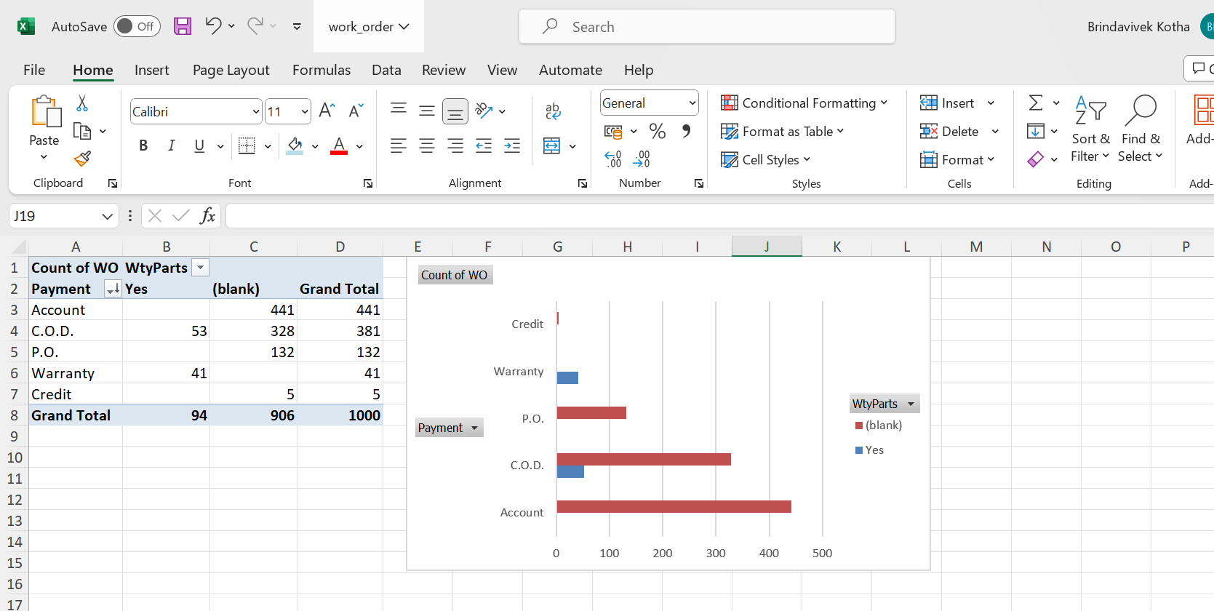
8)Distribution of payment types according to warranty
Payment types of warranty parts are either cod or through warranty.
They don’t use
account or credit as
payment option
Warranty option is 0
for warranty.

Slide 10
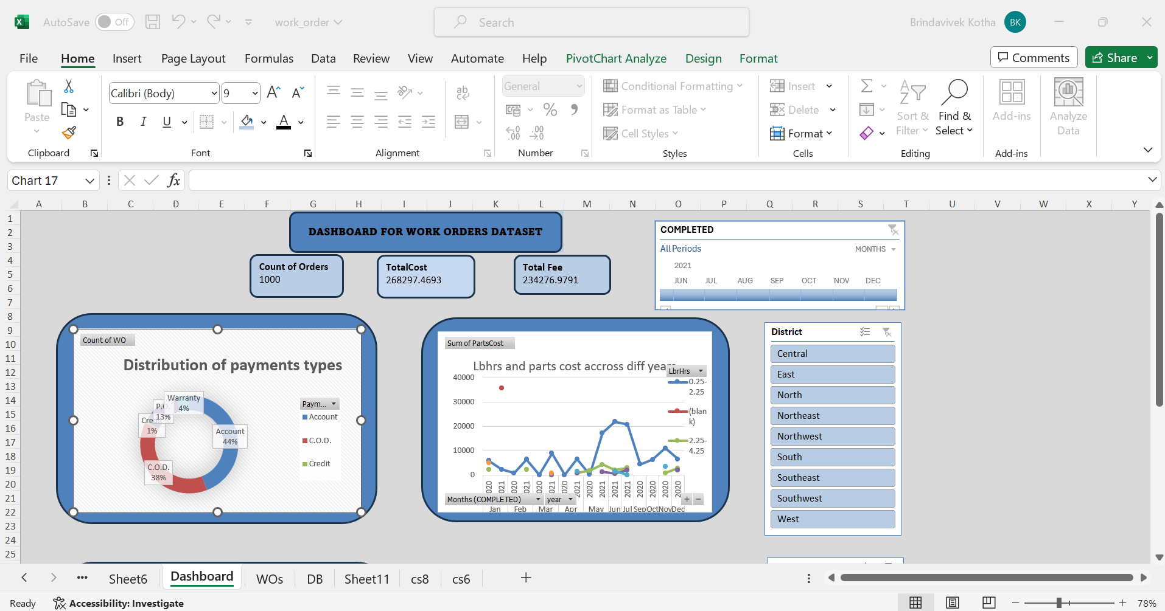
Dashboard

Slide 11
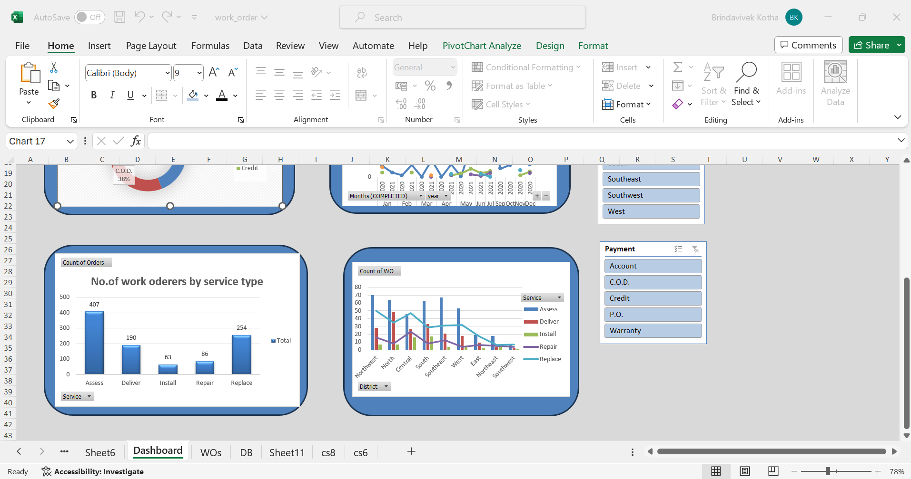

Slide 12
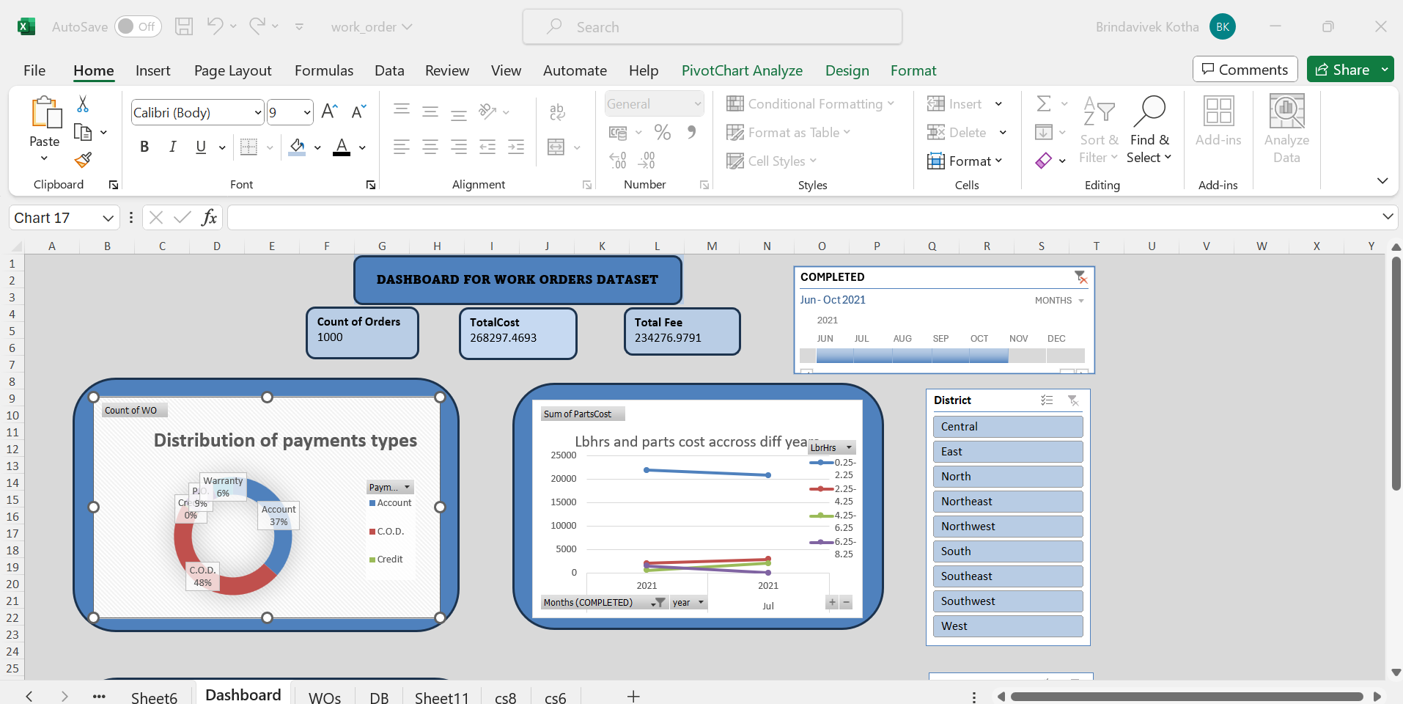
Slicer,time

Slide 13
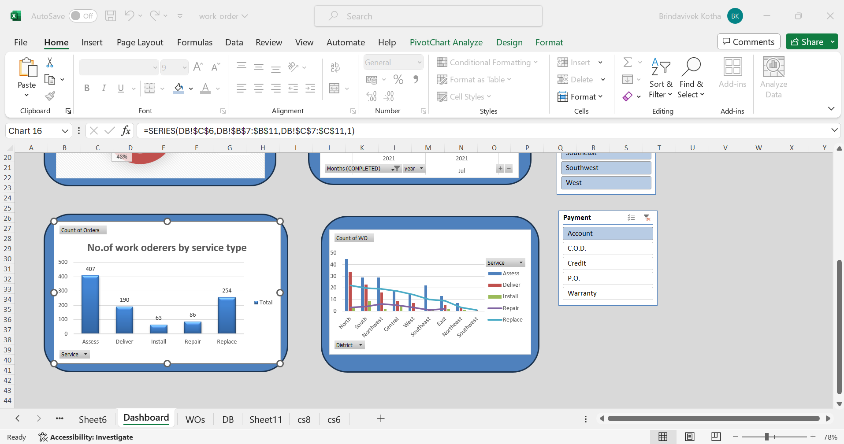
Slicer:

